Slide 1
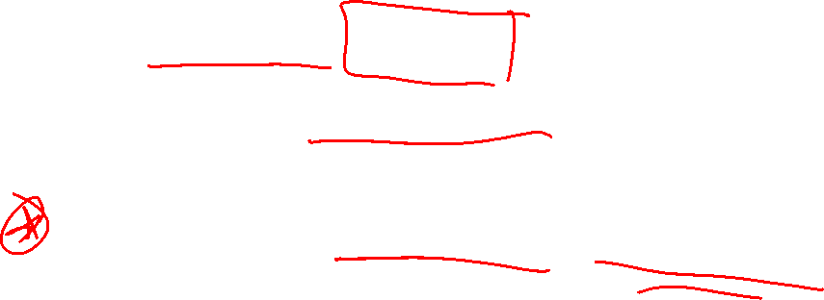
Section 1.6 Solving Other Types of Equations
Lecture 1
Extraneous Solutions, Factor by Grouping, Fractional Expressions

Slide 2

Section 1.6 Homework Submission to Canvas
Preview of section
Skim the section in text and write a short paragraph summary.
Give a bulleted list of all important definitions, theorems, and formulas without details.
Notes on video lectures
Take notes on everything written on slides including all details, worked examples, on-own activities, as well as your own thoughts and questions.
Try on-own activities first, then write down provided solution next to it for comparison.
Worked examples from the text
Write down the problem and attempt without looking at the solution.
Use the solution to write the best explanation you can.
Solutions to textbook exercises
Model approaches and explanations given in the video lectures and textbook examples.
Final reflection of section
List the key takeaways to remember as a bulleted list.

Slide 3
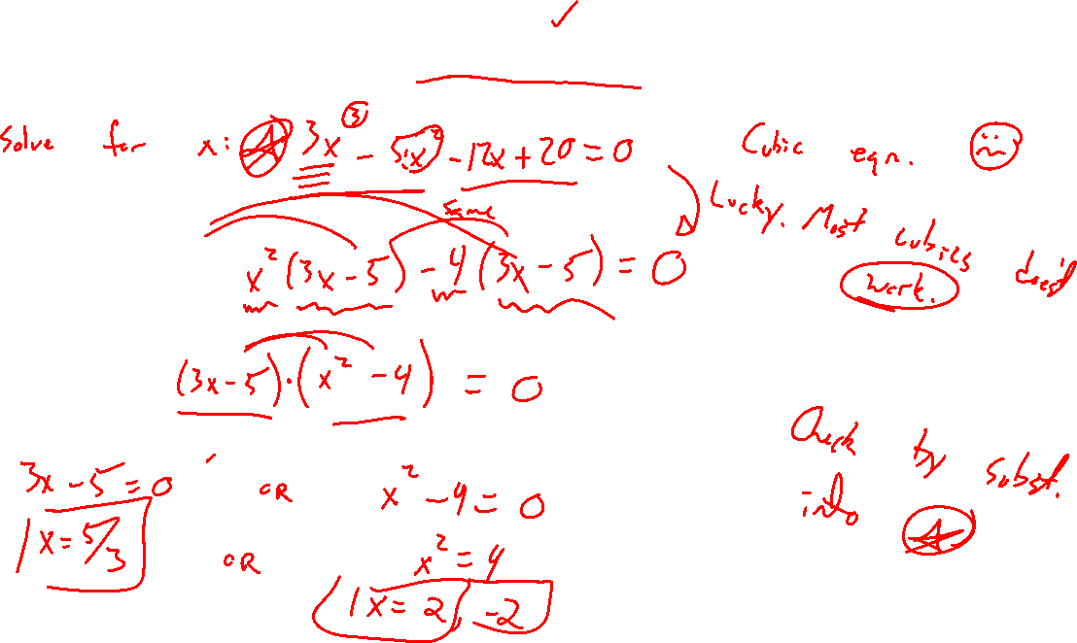
Example: Factor by Grouping
Notes:
3x^3-5x^2-12x+20=0
Note, solving cubics not eas compared to quadratics

Slide 4
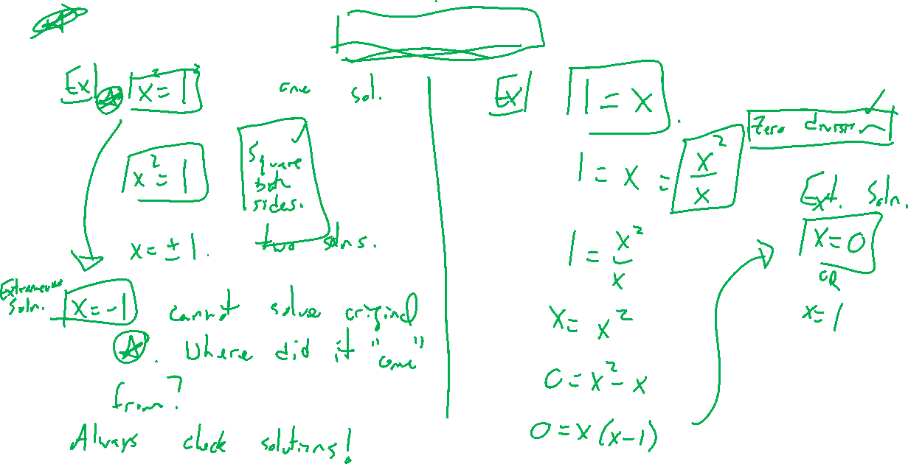
Sneakiness and Extraneous Solutions
Notes:
X=1, x^2=1, x= +- 1, where did it come from? Squaring both sides
1=x = x^2/x gives x^2=x, factor to get two solutions. Zero division and clearing fractions.
Moral, check your solutions.

Slide 5
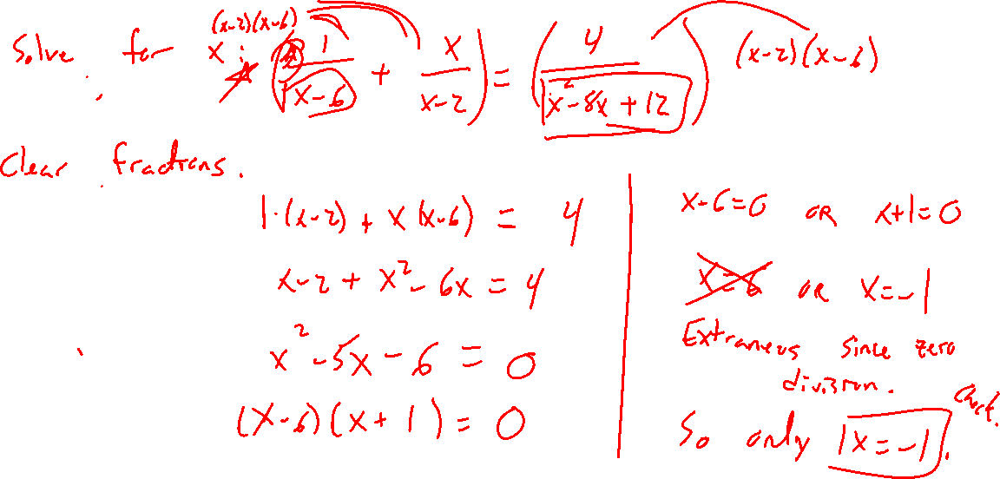
Example: Fractional Expressions
Notes:
1/(x-6) + x/(x-2) = 4/(x^2-8x+12)

